Slide 1
VIMDoS
(Video Meeting Doubt Solving platform)
S.NO | Name | Roll No. | Mentor
1 | K Sai Shashank | 160118733172 | Smt. Suvarna Kumari
2 | P Sai Kiran | 160118733169 | Dr. G. Vivek
3 | V Yashwanth Reddy | 160118733180 | Dr. K. Sagar

Slide 2
Contents
Abstract
Problem Definition
Existing system
Proposed System
Scope of the project
Requirements:
Functional Requirements
Non-Functional Requirements
Software Requirements
Hardware Requirements
Design
Block Diagram
Flowchart
Use Case Diagram
References

Slide 3
Abstract
It is very difficult for the students to get their doubts clarified, mainly who are having their daily classes through E-learning platforms.
To solve this issue we came up with an idea, which we have put in the form of application.
This application allows the users to register their doubts and the students who are having the doubts in the same area are addressed commonly by the respective faculty, through a video meeting.
Through the idea of conducting a video meeting for clarifying all the similar doubts related to a student’s doubt, student not only gets his doubt solved, but gains knowledge on the whole topic related to doubt by viewing others doubts too.

Slide 4
Problem Definition
This is to create a user convenient application with which students can raise their doubts by providing some details like subject, topic of the respective doubt. The respective faculty of a subject addresses the doubts of the students, who are having the doubts in the same topic, through the video meeting.

Slide 5
Existing System
In the present system, when the classes are presented through video meeting and if a student get any doubt, he/she clarifies the doubt in the same class itself or depend on any online sources.
If the students' doubts are clarified in the class, the other students in the class may loss their time and even the faculty cannot complete the syllabus on time.

Slide 6
Proposed system
Generally prevalent method of getting a student’s doubt on e-learning platforms is that the student uploads an image of his doubt on the website, where the community uploads a solution in response to his doubt.
This solves the hour of the need, but through the idea of conducting a video meeting for clarifying all the similar doubts related to a student’s doubt, student not only gets his doubt solved, but gains knowledge on the whole topic related to doubt by viewing others doubts too.

Slide 7
Future Scope
Only responsible for solving student doubts and clearing concepts related to the doubt, not for other student responsibilities like conducting exams, mentoring students etc.
If permission to access College Student and Faculty Database is given, we can implement the same project for our college.

Slide 8
Functional Requirements
Requirements of Faculty:
Scheduling a Video Meet.
Viewing previous Class Requests by students.
Giving feedbacks on student reports.
Requirements of Students:
Registering a doubt.
Filling the student feedback form.

Slide 9
Non-Functional Requirements
The doubts of the students would be classified according to the categories.
Scheduling a class will be easy for the staff.
They can sort out students’ doubts based on the categories and give a personal feedback on their reports if necessary.
Security while logging in and privacy of information is maintained.

Slide 10
Software Requirements
Database – MongoDB
OS - Windows 10
Languages - HTML, CSS, JavaScript
Frameworks – Bootstrap, Angular, NodeJS

Slide 11
Hardware Requirements
System capable of running a Web browser.
Dual core processor and 1GB of RAM.

Slide 12
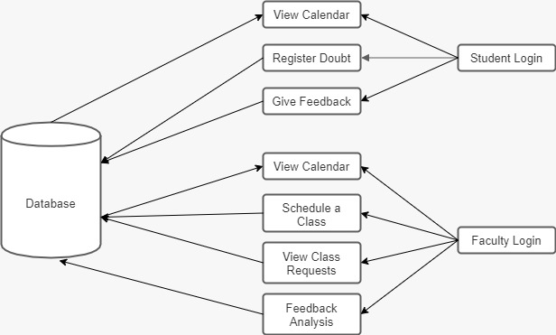
Block Diagram

Slide 13
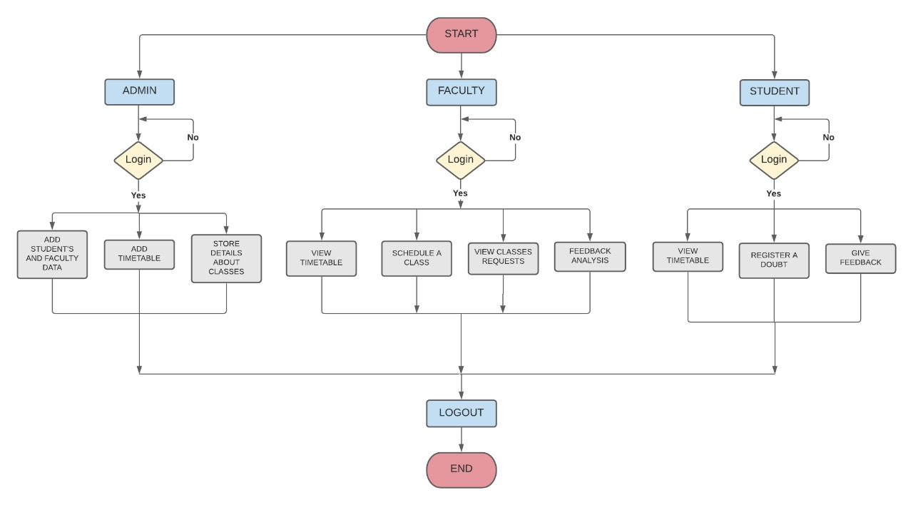
Flow Chart

Slide 14
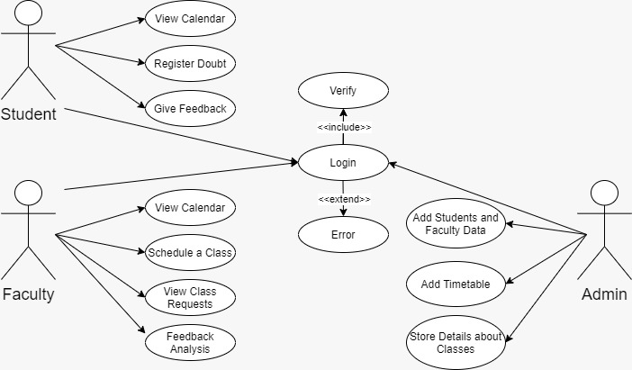
Use Case Diagram

Slide 15
References
http://creative-tim.com
https://sites.udel.edu/ats/conferencing/zoom/canvas/
https://www.tutorialspoint.com/javascript/index.htm

